Slide 1




أكـاديمية طـويق
TUWAIQ ACADEMY
Population details in Saudi Arabia
Amjad Alomani
Aisha Aloumi

Slide 2

Introduction
Population by age groups, gender , nationality and regions in the Kingdom of Saudi Arabia.

Slide 3
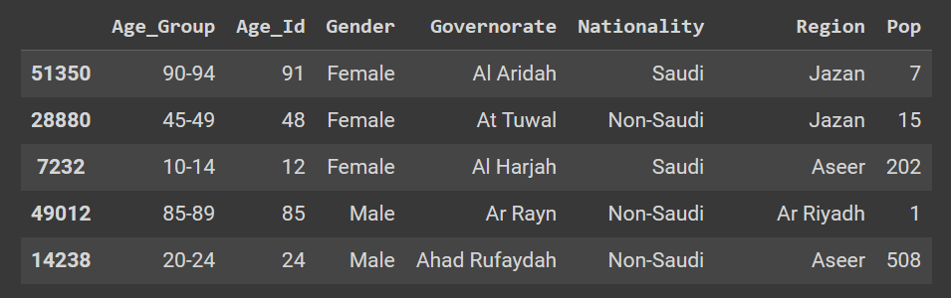
Data table

Slide 4

Nationality by Age
The most densely populated age group is the youth and children age group.

Slide 5
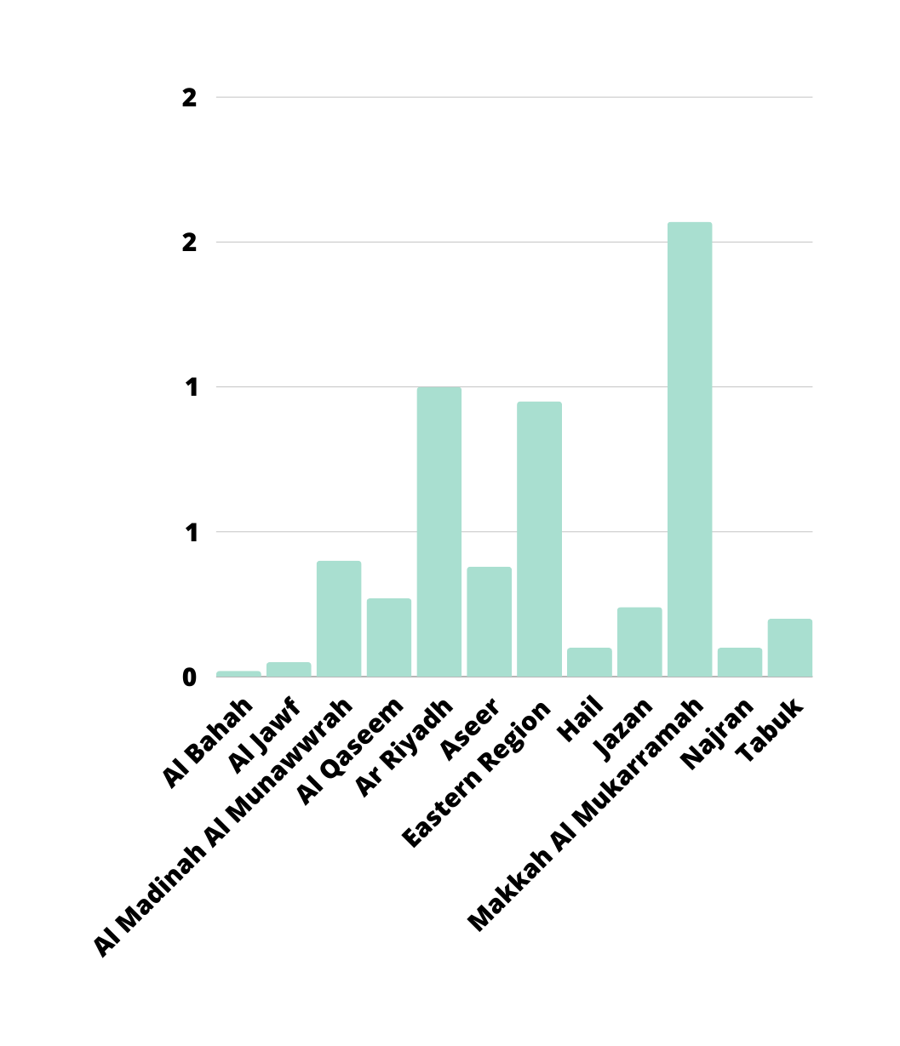
Population density of each region

Slide 6
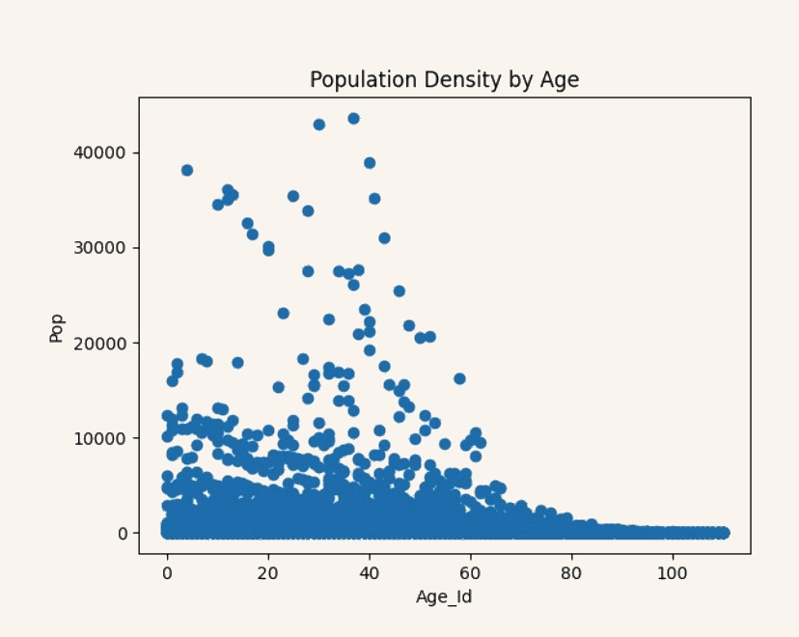
Population Density by Age

Slide 7
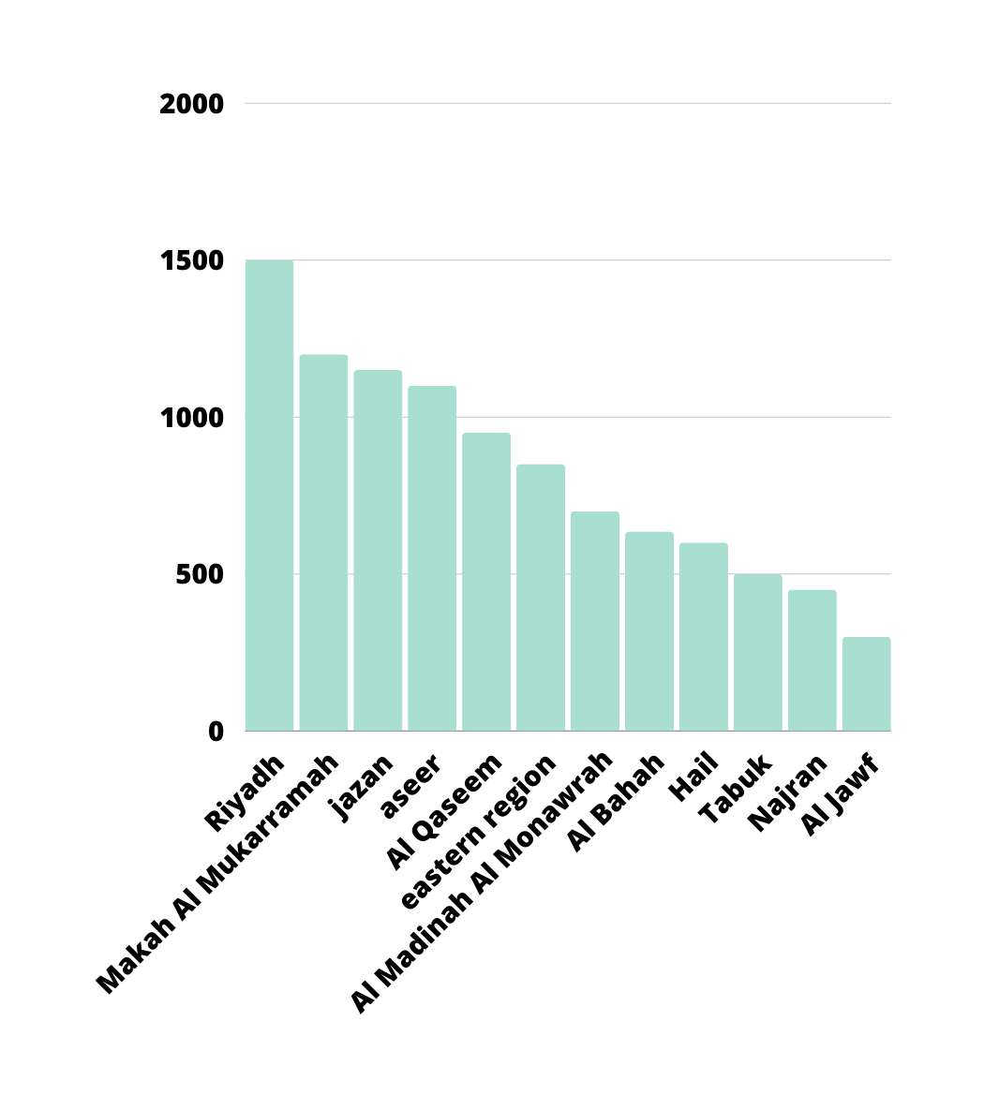
Region analysis

Slide 8

‏Challenges Encountered:
01.Difficulty in searching for large datasets containing 10,000 rows.
02.Slow query performance.

Slide 9

‏Extracted Results:
01.People over the age of 100 are usually found in rural areas and avoid crowded cities.
02.‏The proportion of non-Saudi residents is high due to economic growth in the city and also the tourism sector.

Slide 10

https://open.data.gov.sa/ar/home
General Authority for Statistics in the Kingdom of Saudi Arabia

Slide 11
Thank you !

